Slide 1
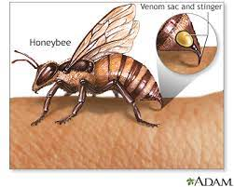
Serum transaminase kinetics in a case of bee sting injury

Slide 2
Introduction
Bee sting patients are not common worldwide
Cases had been reported -Thailand, Vietnam.
Bee sting-fatal complications.
The peptides and enzymes present in bee venom are found to be responsible for anaphylaxis.

Slide 3
Bee venom - melitin, along with phospholipase A2 is responsible for major complications.
We intend to discuss the release kinetics of liver injury in a 55-year-old male following bee sting by swarm of bees.

Slide 4
Case presentation
A 55-year male was brought with history of bee sting (more than 50bees). He had complaints of severe pain and burning sensation over the bite sites. He was conscious and oriented.
He had complaints of fatigue, and swelling over the bilateral upper and lower limbs.
On Examination - multiple bite sites associated with tenderness, redness, and swelling
Pulse rate- 88bpm
Blood Pressure- 100/70mmHg

Slide 5
Systemic Examination:
CVS
RS NAD
P/A

Slide 6
Investigation
Mild increase in the level of total bilirubin, alanine transaminase (ALT) and aspartate aminotransferase (AST) were noticed in Day 1.
Total bilirubin was found to rise since day 1, reaching its peak on day 3 and returned back normal on day 14 whereas alanine transaminase (ALT) and aspartate aminotransferase (AST) also found to rose from the day 1 but reached their peak on day 4, returning back normal on day 16.

Slide 10
Treatment
He was managed with antibiotics, steroids, glutathione.

Slide 11
Discussion
Bee sting venom will lead to liver injury, kidney injury, coagulation problems and anaphylactic reactions in addition to local reaction like cellulitis and edema.
In our case we observed the release kinetics of liver markers.
There was an increase in total bilirubin, AST, ALT from the day 1 and it has reached its peak by day 4 and returned back normal by day 16. We revealed that Patient liver enzymes started to raise slowly from the day 1.

Slide 12
A study on release kinetics of liver markers done in patients who underwent apitherapy by Adel Nazmi Alqutub et al showed that the clinical jaundice was seen after 3rd week of apithearpy with elevation of liver enzymes and returned back normal by 8weeks.
This difference in release of liver markers might be due to amount of bee venom inoculated in apitherapy and bee sting injury as in apitherapy only few bees are used for envenomation and in a case of bee sting injury, huge bulk of bee will inoculate the venom.

Slide 13
Bee venom is composed of various toxins like melittin, apamin, mast cell degranulating peptide, adalopin, phospholipase A2 and hyaluronidase.
Among them, mellitin and phospholipase A2 are responsible for most of the complication seen in bee sting.

Slide 14
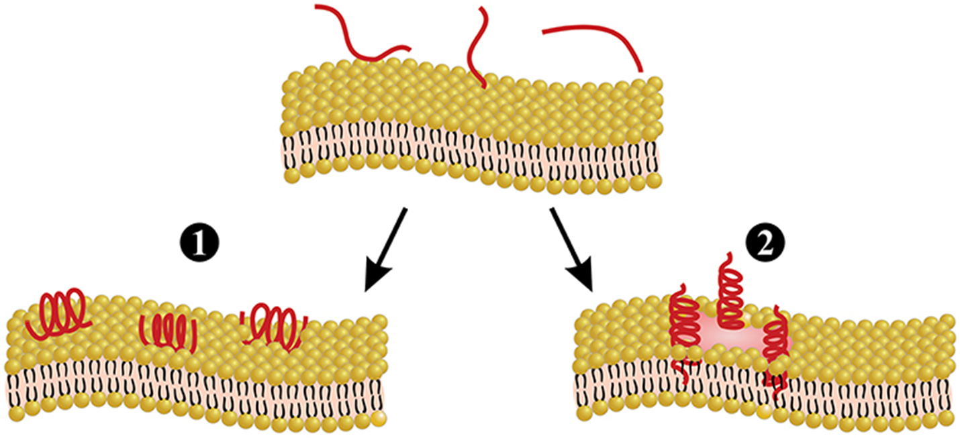

Slide 15
Michael J.Schumacher MB et al in his study he concluded that if the sting is removed within few min after autotomization – can reduce the venom induced toxicity.
Toxicity is directly proportional to amount of venom delivered after stinging event.

Slide 16
Learning points
Markers of liver cell injury raised from day 1 and becomes normal by end of 2nd week which may be mostly attributed by direct toxic injury bee venom compounds like mellitin and phospholipase A2.
Effective and timely management of toxicity may safeguard the hepatocytes and reduce the morbidity.

Slide 17
References
Rim Wehbe , Jacinthe Frangieh, Mohamad Rima, Dany El Obeid, Jean-Marc Sabatier and Ziad Fajloun. Bee Venom: Overview of Main Compounds and Bioactivities for Therapeutic Interests. Molecules 2019, 24, 2997; doi:10.3390/molecules24162997
Xie C, Xu S, Ding F, Xie M, Lv J, et al. (2013) Clinical Features of Severe Wasp Sting Patients with Dominantly Toxic Reaction: Analysis of 1091 Cases. PLoS ONE 8(12): e83164.
Srinivasa Kaligonahall Venkataramanappa, Amban Gowda, Srinivas Raju, and Vijeth Harihar. An Unusual Case of Bilateral Empyema Associated with Bee Sting. Hindawi Publishing Corporation Case Reports in Medicine Volume 2014, Article ID 985720
Adel Nazmi Alqutub, Ibrahim Masoodi, Khalid Alsayari, Ahmed Alomair. Bee sting therapy-induced hepatotoxicity: A case report. World J Hepatol 2011; 3(10): 268-270.
Lim P, Tan IK, Feng PH. Elevated serum enzymes in patients with wasp/bee sting and their clinical significance. Clin Chim Acta 1976; 66: 405-409.

Slide 18
THANK YOU

