Slide 1
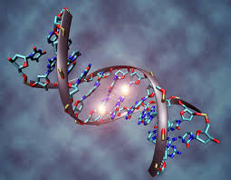
EPIGENETICS

Slide 2
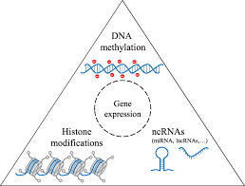
Definition
Focused on the regulation of gene expression by Heritable modifications that do not change the DNA sequence.

Slide 3
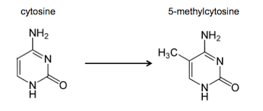
DNA methylation
Well known epigenetic change that is important in X chromosome inactivation, gene Imprinting and cancer.

Slide 4
Cytosine is both methylated and demethylated by variety of enzymes.
Initial methylation – DNA 5 cytosine methyltransferases
Maintance – another type of DNA 5 cytosine methytransferase
It involves 3 types of TET
Family of dioxygenases
Catalyse the conversion of 5 hydroxymethylcytosine ( neuronal cell and regulates gene expression)

Slide 5
Gene expression is altered by methylation via several mechanism.
Most direct effect- by altering the Transcription Factors to bind to promoters.
It decreases the affinity of Transcription Factors to DNA promoters and enhances the binding of specific Transcription Factor
Eg: cancer

Slide 6
Chromatin conformation regulation
Cellular functions requires proteins to interact with DNA
Histone
Nucleosome
Heterochromatin
Decreases the gene expression

Slide 7
Chromatin conformation
Histone modification
Histone variants
ATP dependent remodeling enzymes

Slide 8
Histone modification
Acetylation
Methylation
Phosphorylation

Slide 9
Histone variants
Known for many decades
Function not well established
H3.3 and H2A.Z ---- regulation of gene expression
H3.3 incorporated into chromatin
Independent of replication and associated with active chromatin

Slide 10
ATP dependent remodeling enzyme
Use energy from hydrolysis of ATP to change structure of chromatin
Grouped into 4 families
Non fermentable (SWI/SNF)
Initiation Switch (ISWI)
Inositol requiring 80 ( INO 80)
Chromodomain (CHD)

Slide 11
General properties
Specific attraction with nucleosome
Attraction with modified histone tail residues
Contains ATPase domain
ATPase regulatory function
Ability to interact with transcription factors

Slide 12
SWI & SNF – sliding and ejecting of nucleosome but do not function in chromatin structure
ISWI – changes nucleosome spacing through sliding necessary for DNA replication
Interacts with unmodified histone tails and function to regulate transcription
CHD – slide and eject nucleosome; regulates transcription
INO 80 – insertion n the middle of ATPase Domain
Promoting transcription and DNA repair

Slide 13
Non coding RNA
Most expressed RNA is not translated into proteins
Only mRNA translated into proteins and represent 1% to 5% of total RNA.
Much of non coding RNA known and includes rRNA and tRNA
In last two decades, two large group of non coding RNA have been discovered
Short non coding RNA
Long non coding RNA

Slide 14
Short non coding RNA
Micro RNA
Small interfering RNA
Piwi interacting RNA

Slide 15
Long non coding RNA
Greater than 200nucleotide
The extent of long RNA predicted in hundreds of thousand in vertebrates
Eg: long non coding RNA XIST associated with polycomb group complex 2 inactivates X chromosome by inducing heterochromatin formation

Slide 16
Function of non coding RNA – not known but refered to as competiting endogenous RNA ( CeRNA)
Competition for shared mi RNA binding site in untranslated region

Slide 17
Thank you

