Slide 1
FLOW CYTOMETRY

Slide 2
CONTENTS
Definition
Principle
Instrumentation
Application

Slide 3
Cytometry
Measurements of physical and chemical components
FLOW CYTOMETRY: process where such measurements are made while cells or particles pass, preferably in single file, through the measuring apparatus in a fluid stream.

Slide 4
Principle
Based on the measurement of light scattered by particles and fluorescene observed when these particles are passed in stream through laser beam

Slide 5
Cells / molecules labelled with specific fluorescent labels
Beta phycoerthrin
Fluorescien isothiocyanate
Rhodamine 6 G
Other dye labelled antibodies

Slide 6
Most of FC incorporates 2 or more fluorescence emission system
multiple fluorescent labels can be used
By this manner particles classified according to
Size
Shape
Type of light scattering
Fluorescent properties

Slide 7
Instrumentation
Fluidic system
Optical system
Electronic system

Slide 9
Most commercial FC uses 2 or more laser light source
Eg; LSR II (BD biosciences, Rockville Marryland)--- with 7 lasers
UV 355nm
Voilet 405nm
Blue 488nm
Green 532nm
Yellow 594nm
Red 638nm
Infra red 785nm
Simultaneously measure 18 emission spectra

Slide 10
Applications
Able to measure multiple parameters
Cell size
Granularity
DNA content
RNA content
Chromatin structure
Antigens
Total protein content
Cell receptors
Membrane potential
Ca ion conc as the function of pH

Slide 11
Used in hematology, immunology, oncology, microbiology, virology.
Potential application for development of sensitive laser induced fluro immunoassay
FC combines with microspheres used as solid support for conventional Immunoassays, Affinity assays and DNA hybridization assay

Slide 12
SIZE EXCLUSION CHROMATOGRAPHY

Slide 13
CONTENTS
Definition
Principle
Materials used
Application

Slide 14
Definition
Separation based on the size and shape which utilizes the molecular sieve properties of variety porous materials
PRINCIPLE:
Based on the column of gel particles is in equilibrium with a suitable mobile phase for the molecules to be seperated

Slide 16
Mobile phase absorbed by a gel available for an analyte dependent upon porosity of gel particle & size of analyte
This distribution of analyte in a column is determined by volume of mobile phase
Kd (distribution coefficient) for large particle is 0
Kd is 1 for small particles
Kd varies from 0-10 for intermediate particles

Slide 17
Materials commonly used
Cross linked dextrans
Agarose
Polyacrylamide
Polyacrylolylmorphine
Polystyrene

Slide 18
Applications
Purification
Relative molecular mass determination
Solution concentration
Desalting
Protein binding studies

Slide 19
HIGH PRESSURE LIQUID CHROMATOGRAPHY

Slide 20
CONTENTS
Columns
Pumps
Application of sample
Detectors
Application

Slide 21
Has emerged most popular , powerful and versatile form of chromatography.
COLUMNS:
Made of stainless steel
TYPES:
Straight columns
Microbore columns
Open tubular columns
Preparative columns

Slide 22
MATRICES AND STAIONARY PHASE
Three forms of column packing materials are used.
Microporous support
Pellicular support
Bonded phase

Slide 23
Column packing
HPLC column can be purchased
Majority priority in packing of column is to obtain uniform bed of materials with no cracks / channels
Widely used technique for column packing is High pressure slurrying technique

Slide 24
Mobile phase and Pumps
Depend on the type of separation achieved
Isocratic separation
Solvents used in HPLC should be free from impurities
Pumping system for delivery of mobile phase is one of the most important features in HPLC
Constant displacement pumps
Reciprocating pumps

Slide 25
Application of sample
Correct application of sample to HPLC column is important factor in achieving successful separation
Two methods generally used
Use of microsyringe
Loop injection

Slide 26
Detectors
Ultra violet visible spectrometry
Scanning wavelength detectors
Absorbance detector
Fluorescence detector
Electrochemical detector
Refractive index detector
MS
Conductivity detector

Slide 27
Ultra violet visible spectrometry
Capable of measuring absorbance down to 190nm
Scanning wavelength detectors:
Have facility to record the complete absorption spectrum of each analyte thus aiding identification

Slide 28
Fluorescence detector
PRINCIPLE: measures the ability of chemical to absorb and reemit light through fluorescence

Slide 29
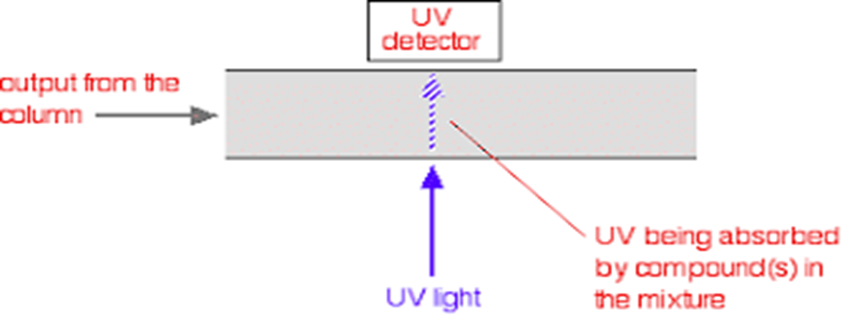
Absorbance detector
PRINCIPLE: measures the absorbance of light at a given wavelength

Slide 30
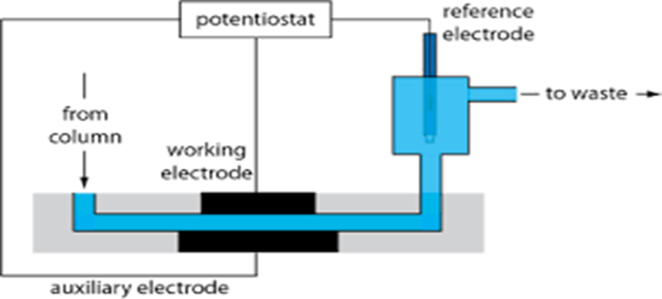
Electrochemical detector
PRINCIPLE: measures the current as the result of chemical oxidation or reduction

Slide 31
Conductivity detector--measures the change in the conductivity of MP as ions elute from the column.
REFRACTIVE INDEX DETECTOR: measures change in refractive index of MP as compounds elute from the column

Slide 32
THANK YOU

